Slide 1
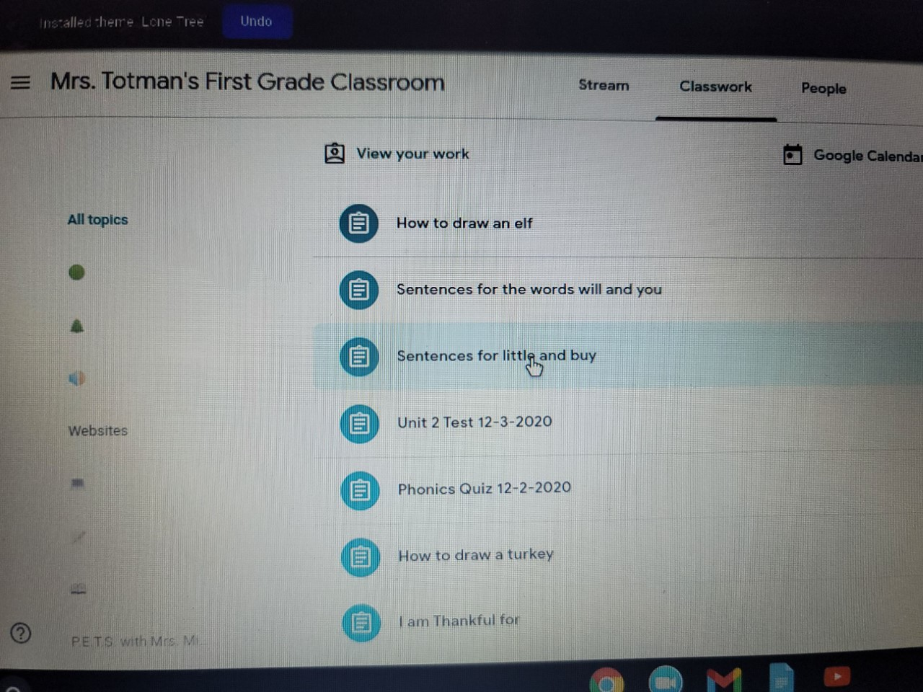
Step 1: Uploading classwork image to Google classroom
From your Google classroom under the Classwork tab, select / click the assignment you want to complete.

Slide 2
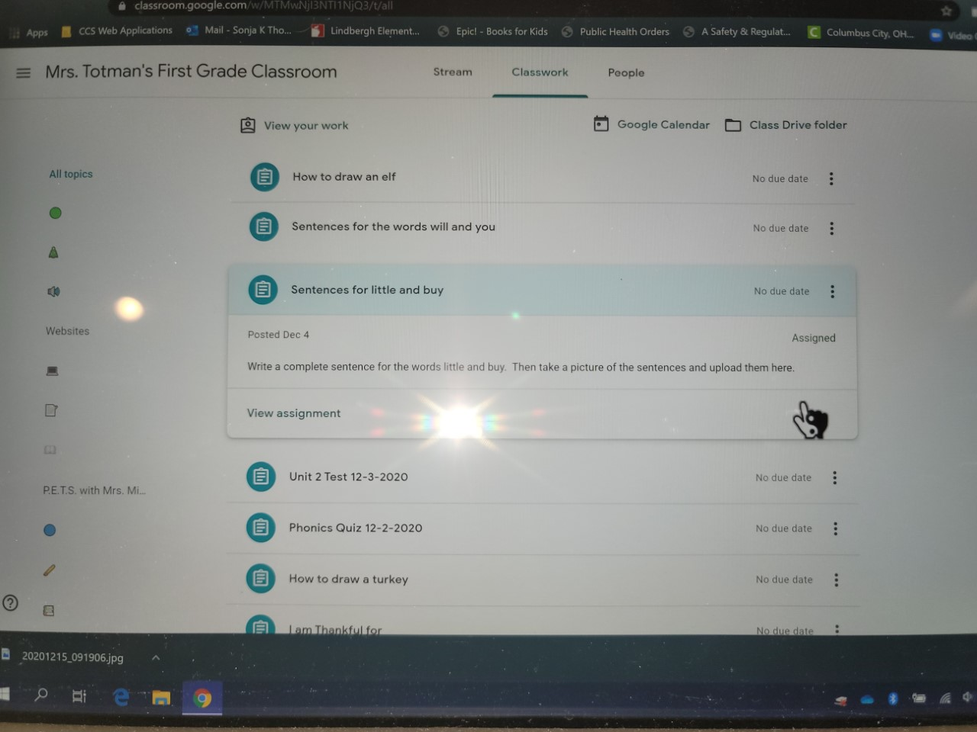
Step 2
Read and follow the directions for the work you are completing.

Slide 3
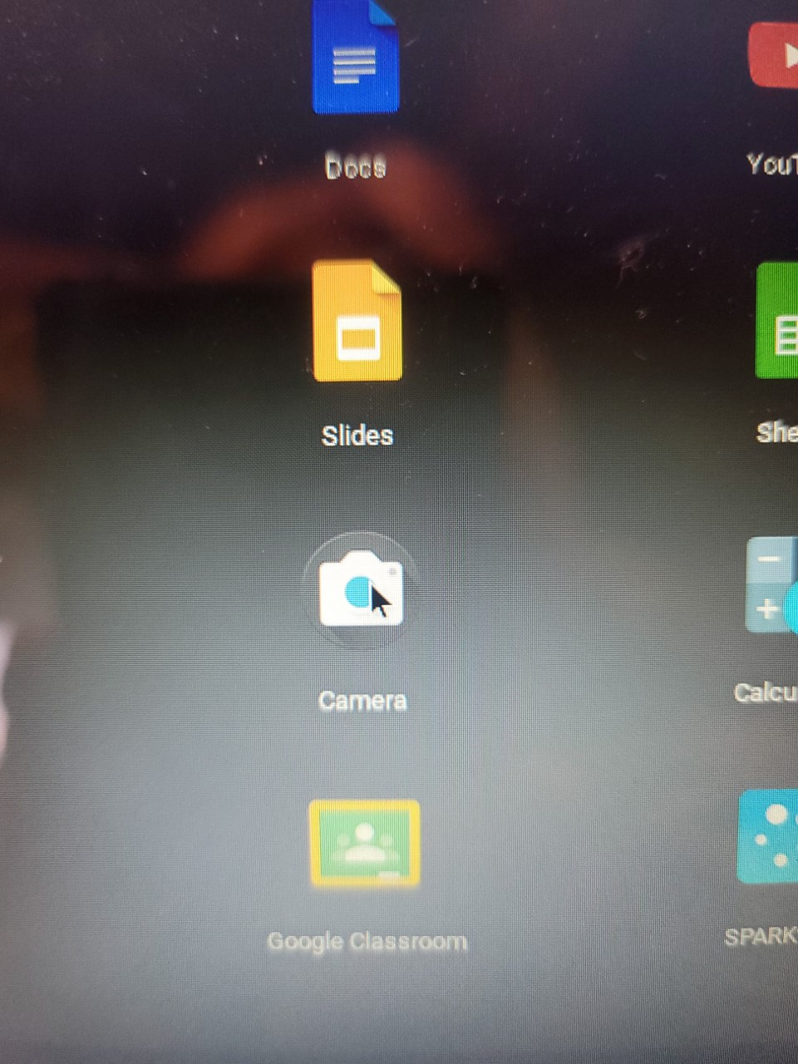
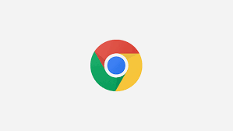
Step 3
Select the camera icon to open the camera (you may have to click the Red, Green and Yellow Google icon located in the bottom middle of your chromebook screen to open the menu to select the camera)

Slide 4
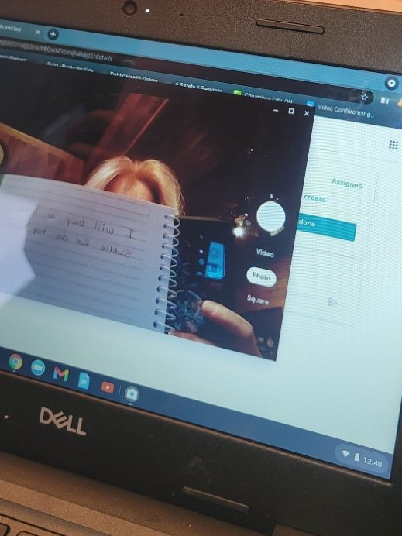
Step 4
Hold your work in front of the camera on the computer screen and click the White Circle on the right side to take a picture.

Slide 5
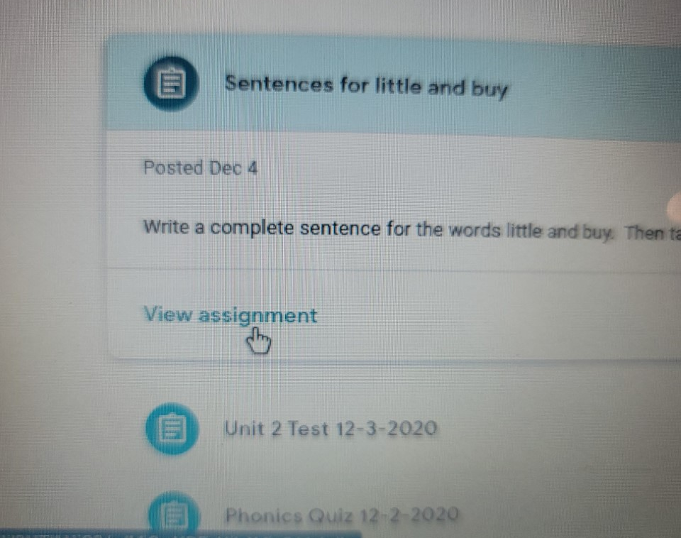
Step 5
Close the camera.
From the Classwork tab, select the assignment that you are working on and click View Assignment.

Slide 6
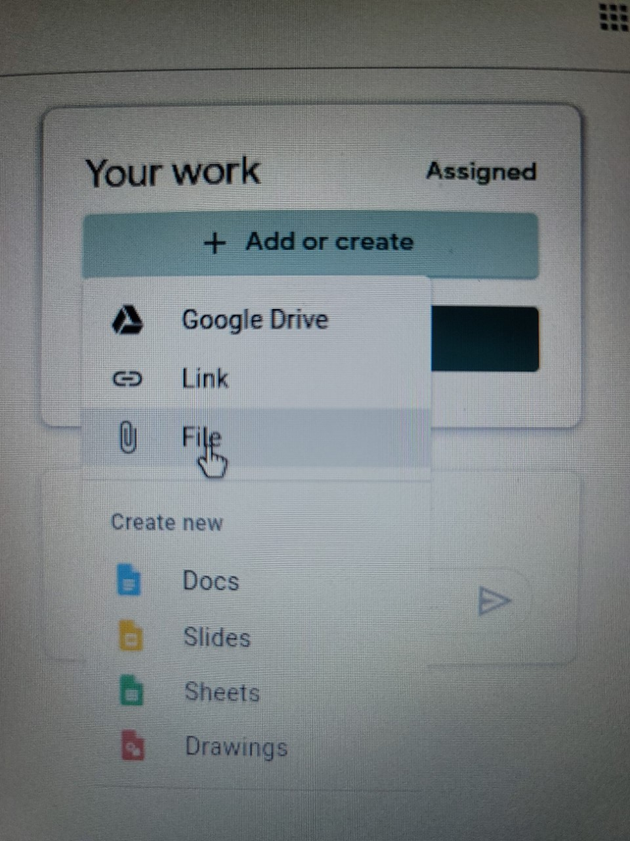
Step 6
Click the + Add or Create button in the Your Work box in the upper right part of the screen.
Select the paper clip/ file option

Slide 7
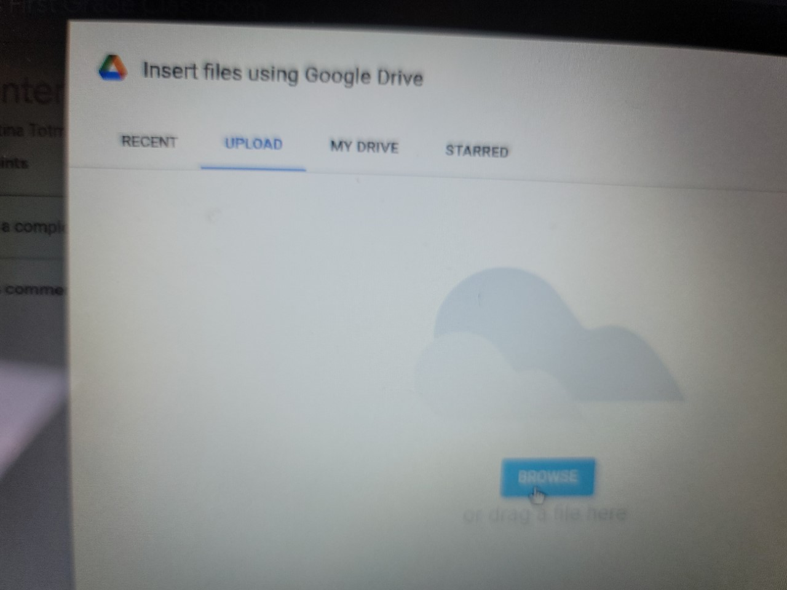
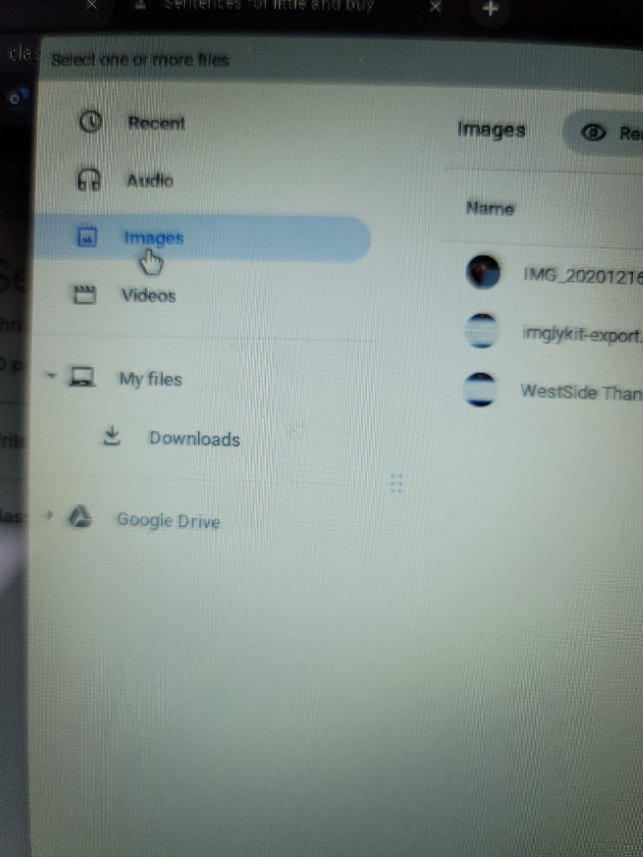
Step 7
Choose upload and click Browse
Select Images from the menu on the left side of the screen.

Slide 8
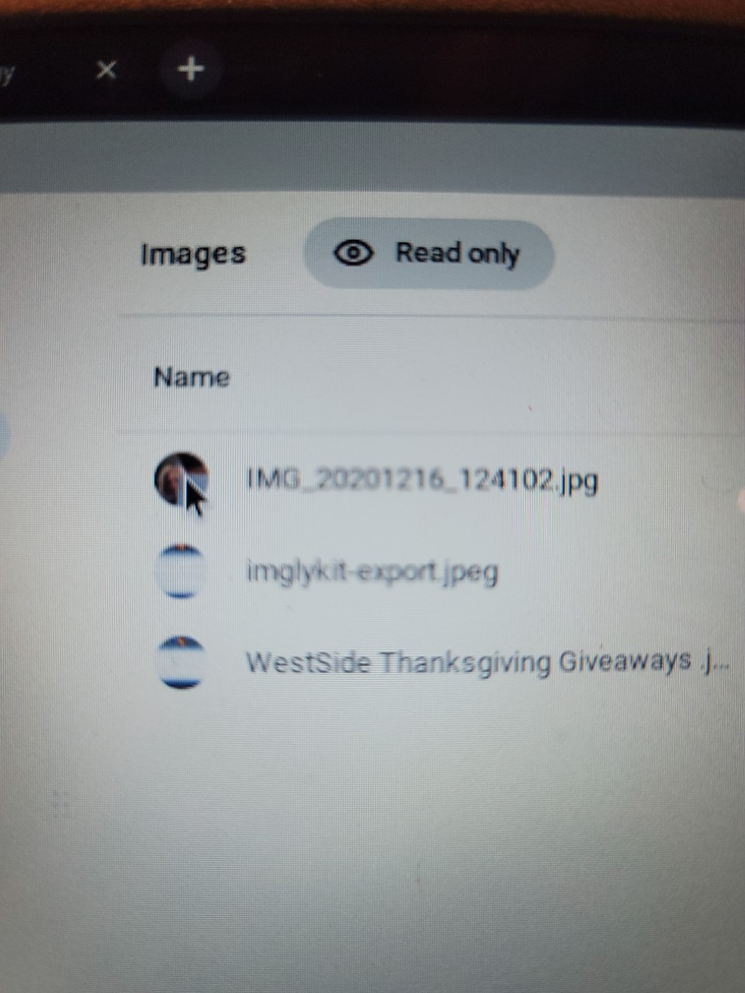
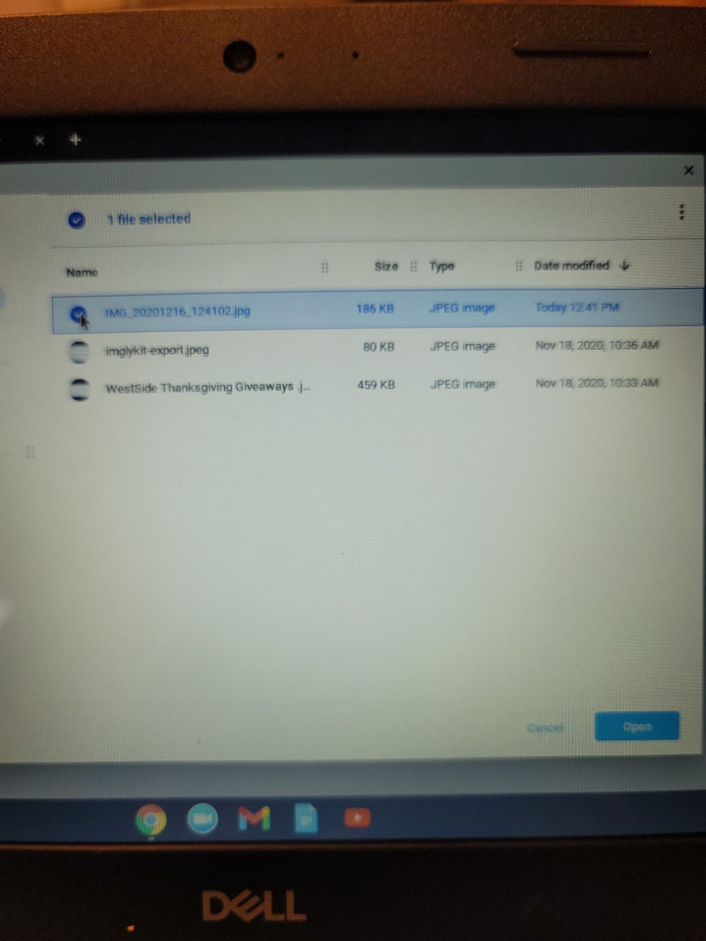
Step 8
Select the image you want to use.
Click Open in the bottom right corner.

Slide 9
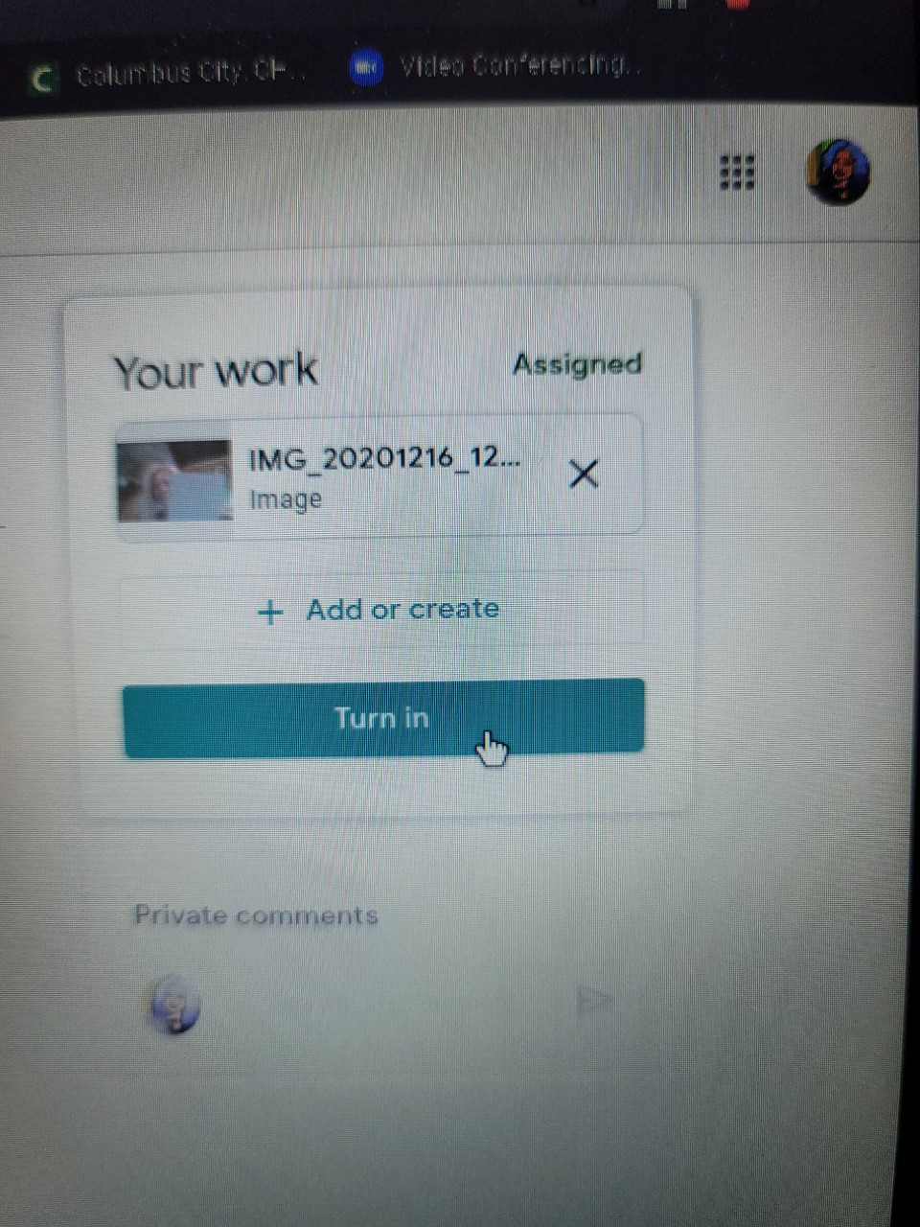
Step 9
The image will upload to the Your Work box.
Click the blue Turn In button.

Slide 10
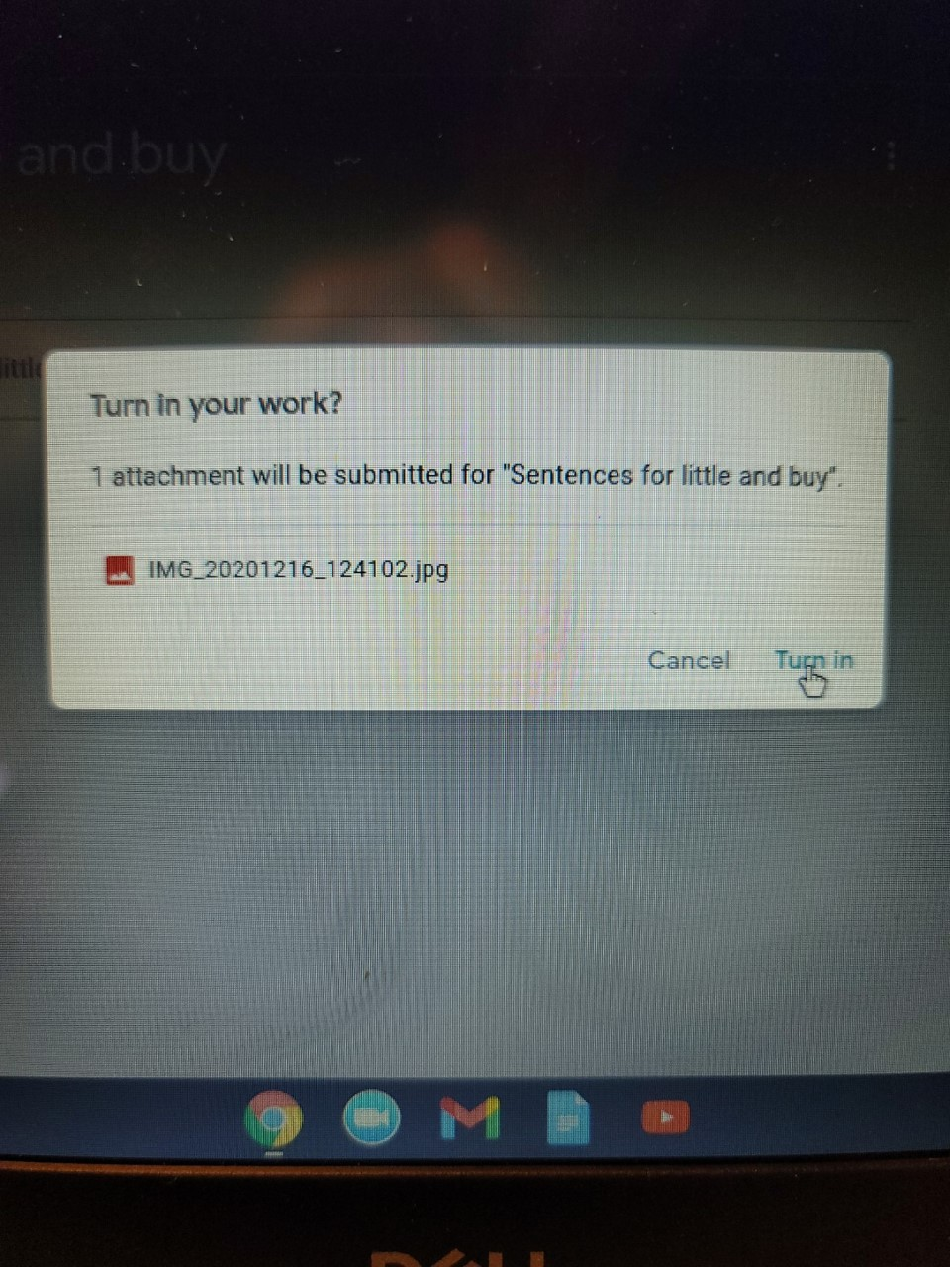
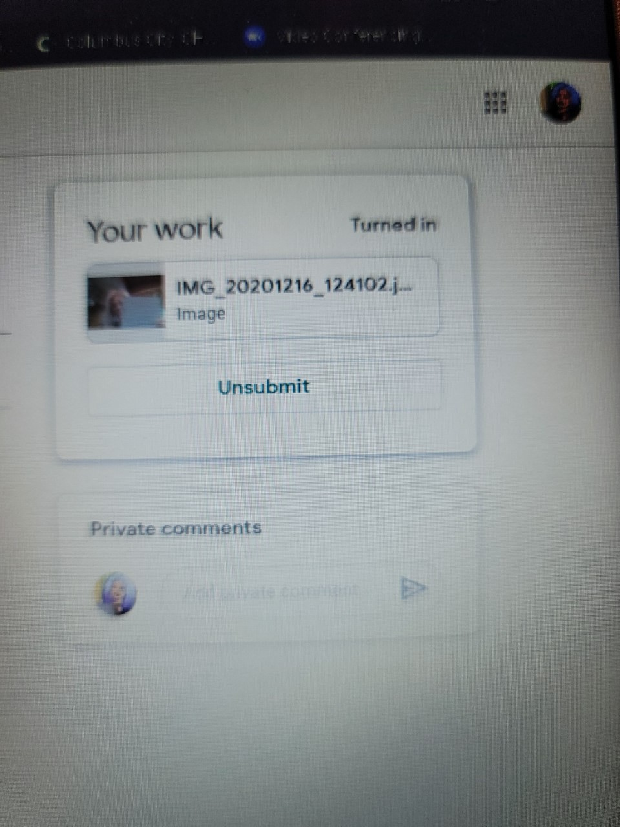
Step 10
Select Turn In.
Once the turn in button is clicked, the work will upload and the Turn In will change to Unsubmit. You will see your document in the Your Work box.

